Slide 1

Online Learning
in your community!

Slide 2
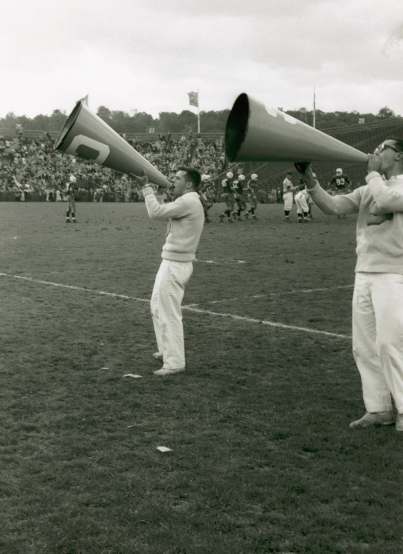
WE ARE
Community-based
Helping Ontarians
In remote, rural, Indigenous & Francophone communities
Access to education leading to jobs
IN YOUR COMMUNITY
Notes:
As a community-based organization, Contact North | Contact Nord helps underserved Ontarians in 600 small, rural, remote, Indigenous and Francophone communities get jobs by making it possible for them to access education and training without leaving their communities.

Slide 3

WE OFFER
Program & course information
Registration help
Financial aid options
Tech support
Exam invigilation
Community referrals
Support & encouragement

Slide 4

REACH OUT
Employment offices
HR officers
Ontario Works Offices
Notes:
KEEP MOVING FORWARD!
If you are unsure about what certifications you may need to fast forward your career, REACH OUT to your local employment office, your human resource officer or a qualified employment coach to build up your résumé. Contact North offers access and options to academic pathways, but not employment support!

Slide 5


DID YOU KNOW?
1,000
online programs
18,000
online courses
Notes:
Contact North’s studyonline.ca website offers 1000 online programs and 18000 online courses offered by (go to next slide)

Slide 6

24 colleges
22 universities
76 school boards
9 Indigenous institutes
200 basic skills providers
50 training skills providers

Slide 7

Online Learning Center located in Colbourne Building
Notes:
An online search can be daunting. There are millions of online courses worldwide that pop up during your search… how do you sort through them?
Ask Yourself:
Fun, Personal Growth or Professional/Business
Quick tutorial, weekend commitment, weekly dedication or long term dream?
Just for knowledge, badge certificate, diploma, degree or professional designation
Free, Low Cost, OSAP Eligible
Studyonline.ca can help!

Slide 8
The centre has the following resources available for use:
Web conferencing, videoconferencing and audioconferencing
technology platforms to connect to courses
High-speed Internet
Computer workstations
Full technical support
Notes:
An online search can be daunting. There are millions of online courses worldwide that pop up during your search… how do you sort through them?
Ask Yourself:
Fun, Personal Growth or Professional/Business
Quick tutorial, weekend commitment, weekly dedication or long term dream?
Just for knowledge, badge certificate, diploma, degree or professional designation
Free, Low Cost, OSAP Eligible
Studyonline.ca can help!

Slide 9

FREE!
FREE!
FREE!
(Yes, Virginia, there ARE free courses!)
Notes:
This slide is to promote the free courses that would be of interest to your audience.
For those who don’t get the reference to Virginia, go to https://en.wikipedia.org/wiki/Yes,_Virginia,_there_is_a_Santa_Claus. (Figured the guy in the photo could be Santa in everyday clothes!)

Slide 10


Professional Development

Slide 11

Professional Development

Slide 12
Professional Development
Health & Safety
Computer Programs such as MS Word, Excel
Bookkeeping
Customer Service
Communication in the Workplace
Conflict Resolution
Presentation Skills

Slide 13

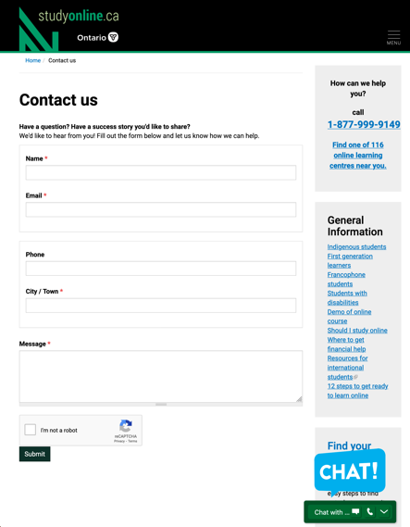
Live audio or messaging chat
Notes:
Call 1-877-999-9149 to chat with one of our LIVE agents to help you navigate our database… with custom study options based on YOUR needs!

Slide 14

Contact me directly
Colleen Leduc
Online Learning Recruitment Officer
807 228-3587
colleen@
contactnorth.ca

Slide 15

You can’t start the next chapter of your life if
you keep
re-reading
the last one.
Amy Rees Anderson

Slide 16


